Slide 1
State Information Technology Agency
2008/9 Annual Report Presentation to (PSA) Portfolio Committee

Slide 2




Agenda
Strategic Objectives : Achievements
Key Integrated Service Provision Programs
Human Capital
Financial Performance
OPERATIONAL
EFFICIENCY
IMPROVED
SERVICES
CUSTOMER &
STAKEHOLDER
SATISFACTION
FINANCIAL
SUSTAINABILITY

Slide 3
Achievements: Strategic Objectives

Slide 4

Ensuring that ICT works for the Citizens
Improve Long-Term Financial Sustainability
Results for South Africa
Financial Responsibility
Optimise Revenue Streams
Leverage Assets optimally (people & resources)
Optimise Working Capital
Improve Cost Structure
Financial
Be a Trusted Advisor
E- Innovation
SITA Process Excellence
Service Excellence
Modernise Public Service Operations
Reduce Government Cost of Doing Business
Optimise ICT Infrastructure Services
Improve Responsiveness
Consistently Meet Service Levels
Customer
By Leveraging Industry Partnerships we will
Extend Service Footprint
Maximise Efficiency of Processes
Improve Service Level Management
Improve the Management of Service Portfolio
Internal Process
Encourage Innovation Culture
Standardise & Automate Process
Understand Customers‘ Business & Needs
Learning &
Growth
Embed SITA Culture & Values
Develop Skills
Improve Accountability
Attract & Retain Talent.
Build Leadership & Management Competencies

Slide 5
Achievements: Strategic Objectives
Objectives/Target Set as per 2008/9 SITA Corporate Score Card:
Achieved = 19
Not Achieved = 8
Categories for Objectives:
Financial = 4 Objectives with 5 set targets
Customer = 10 Objectives with 10 set targets
Internal Processes = 4 Objectives with 5 set targets
Learning and Growth = 5 Objectives with 7 set targets

Slide 6
Achievements: Strategic Objectives
Objectives achieved:
  Grow revenue base
  Develop and implement an integrated, consistent and robust planning cycle regime
  Develop detailed service catalogue and service metrics
  Quality of service sample
  Develop and implement the service offerings to local government using Shared Services model
  Improve quality of revenue and reduce costs to customers for agency transactions
  IFMS ( Integrated Financial Management System)
  Develop and implement ICT Planning Governance Framework
  E-Gov

Slide 7
Achievements: Strategic Objectives
Objectives achieved (continued):
  GWEA ( Government Wide Enterprise Architecture)
  Quality improvement – including implementation of an IT Service Management Framework
  Improve business processes
  Develop skills ( Identified Core and Critical Skills)
  Focus on embedding SITA organizational values to ensure they are instilled in the way we work
  Attract and retain critical skills and best performers
  Develop and implement an Integrated Talent Management Strategy
  Attainment of employment equity: EE and Disability

Slide 8
Achievements: Strategic Objectives
Objectives not achieved
  Achieve working capital and cash flow targets
  Develop, implement and maintain competitive costing and sustainable pricing strategies (commercial models)
  Convert all licensed software with a significant share of total government ownership to a single enterprise license
  Signing of Service Level Agreements
  Clean Audit Report
  Implement procurement-specific interventions to improve operational excellence
  Attainment of employment equity targets: Gender

Slide 9
Key Integrated Service Provision Programs
Government Programmatic Support
Local Government Support Program (Municipal ICT blueprint)
The Local Government Support programme is an initiative designed for the purpose of identifying solutions, testing the concepts applicable to identified local government requirements with the intention of implementing these solutions in municipalities.
Electronic Health record
The objective of the Electronic Health Record project (e-HR.Za) is to design and develop a solution for an Electronic Health record for South Africa that will allow the Department of Health (DoH) to have a single view of patient information across the country.
SAPS and DoD
These are outsourced ICT accounts that SITA manages on behalf of these clients.
Education: Lurits
The National Education Department has identified the need to design and implement a national learner unit record information and tracking system (LURITS). The LURITS is a web-based system that will enable the DoE to store the unit record level data of learners and educators in a central national database and will enable the Department to track the movement of learners from school to school throughout their school career.
Poverty Index
This initiative is intended to help in the validation of information of people applying for indigent grants.
IEC Call Centre (and now Presidential Hotline)
These initiatives showcase how optimization of existing ICT infrastructure can reduce the life cycle costs of solutions to government.
Youth Development Programme (Youth Internship Programme)
This programme offers unemployed diplomates and graduants an opportunity to enter into the ICT world through a year long internship programme.

Slide 10
Key Integrated Service Provision Programs
Modernizing Government Systems
Government-wide Enterprise Architecture (GWEA)
The value of this framework would empower government ICT entities to: align their ICT plans and capabilities with departmental business plans and capabilities; to make informed decisions pertaining ICT investment, acquisition and development; to identify and reduce duplication of ICT; to improve security and interoperability among government information systems.
Next Generation Network (NGN)
The asset provides new capability to offer fully converged communications network that offers functionality such as data, voice and video transmission in a defines quality of service framework.
Network Operations Centre (NOC)
This asset enables SITA to proactively monitor the NGN to minimize network outages that may negatively affect service delivery.
Integrated Financial Management System (IFMS)
The purpose of the IFMS project is to consolidate, integrate and upgrade Government’s out-dated legacy transversal I.T. systems in order to meet new legislative and organisational requirements, introduce cost-effective technologies, eliminate duplication, support e-Government initiatives and contribute to broader socio-economic objectives such as contributing to skills development and stimulating the domestic ICT industry, particularly BEE and SMME companies.
Next Generation e-Government
Establish an e-Government platform that is central, scalable, flexible, extensible, reliable, customizable, and integrated on which online services can be delivered to citizens/business/foreigners, etc.
Implementation of Free Open Source Software (FOSS)
This initiative is intended to deliver numerous outcomes among which are to (1) develop skills for FOSS (research showed this was the key problem) (2) Promote open standards and open source (3) Facilitate migrations to FOSS by government departments (Migrations can be application, desktop, back-end, enterprise systems)

Slide 11
Human Capital

Slide 12
Equity Performance
Employment Equity:
Actual Target
Race → 62.83% - 60%
Gender → 45.87% - 46%
Disability → 1.34% - 1%

Slide 13
Key Human Capital Programs
Development of Core Technical Skills
Development: Leadership and Management Skills
Culture Improvement
Youth Internship Programme

Slide 14
Financial Performance

Slide 15
Governance Structure
Audit and Risk Committee
Strong Internal Audit
Anti-Fraud hotline
All issues reported are investigated and appropriate action taken

Slide 16
Audit Report
Previous year
  Unqualified
  Emphasis of matter
Current year
  Unqualified
  No emphasis of matter

Slide 17
Audit Report (continued)
Items included in other matters:
  Non-compliance with PFMA:
    Contract Management System not in place
    Approval to retain surpluses not requested from National Treasury
  Non-compliance with SITA Act
    Service Level Agreements not signed
    Vacant prescribed Directors positions -- Managing Director and Legal Representative
  Key Governance Responsibilities
    Audit delays
    Material audit adjustments to the annual financial statements (Projects)
    Internal control weaknesses
    Non-compliance with legislation
    Information systems not supportive
    Unresolved prior year audit findings
Various investigations as reported on in the audit report

Slide 18
Financial Performance
Revenue increased with 10% in line with the budget. Tariffs within the mainframe environment were lowered resulting in R225m less revenue than budgeted.
Suppliers were paid more promptly, but challenges were experienced in timeous debt collection. This impacted negatively on working capital and the organisation generated less cash from operations than budgeted. This impacted on our capital expenditure program.
Notwithstanding the above challenges and strategies put in place to address these problems, our solvency ration at the end of the year was 2.41:1 and our liquidity ratio was 1.98:1, leaving the company healthy and the financial structure sound.

Slide 19
Financial Performance, …
Highlights:
  Revenue growth of 10% to R3,976 bn
  Significant reduction in supplier payment periods
  Solvency ratio 2.41:1
  Liquidity ratio 1.98:1
Areas for improvement:
  Debtor days: 65.87 days vs target of 65 days
  Cash generated by operations: R87m vs budgeted R163m

Slide 20
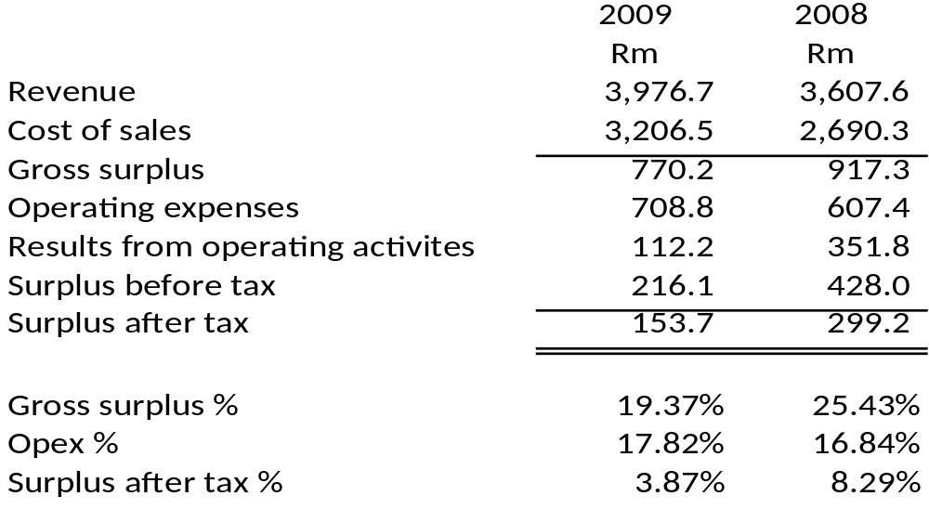
Abridged Statement of Financial Performance for the year ended 31 March 2009

Slide 21
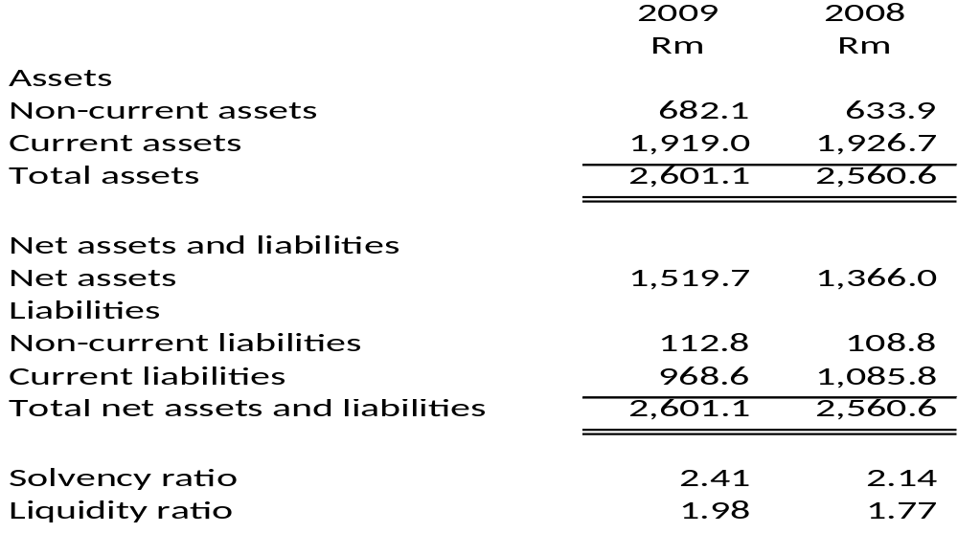
Abridged Statement of Financial Position as at 31 March 2009
Benchmark: Solvency ratio – 2:1, Liquidity ratio – 1.5:1

Slide 22
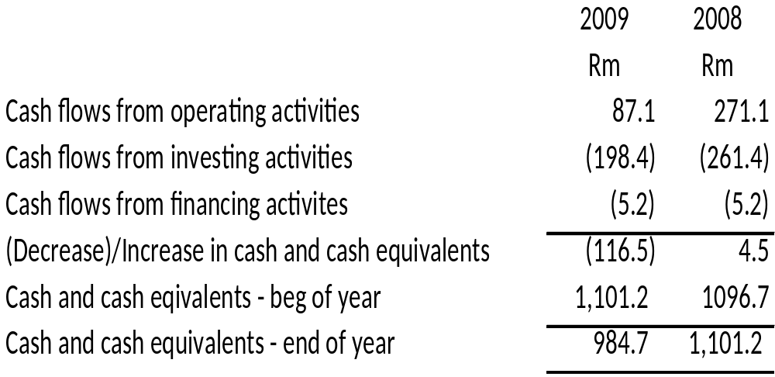
Abridged Cash Flow Statement for the year ended 31 March 2009

Slide 23
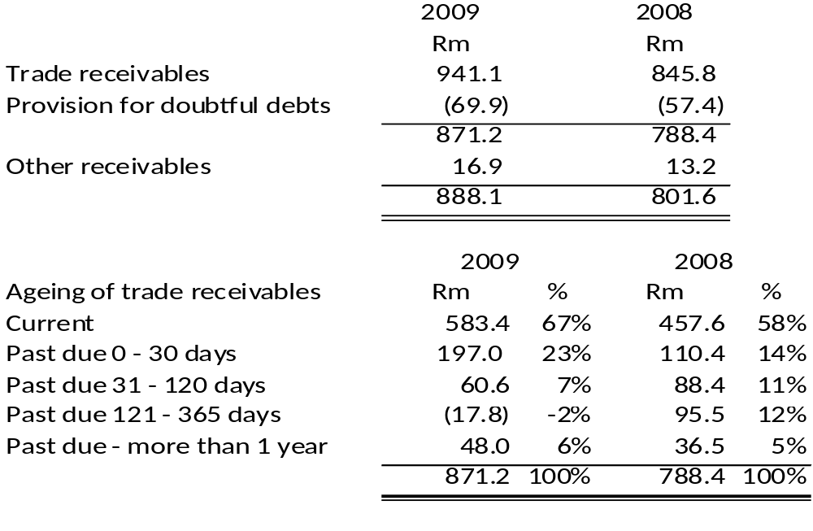
Trade and other receivables

Slide 24
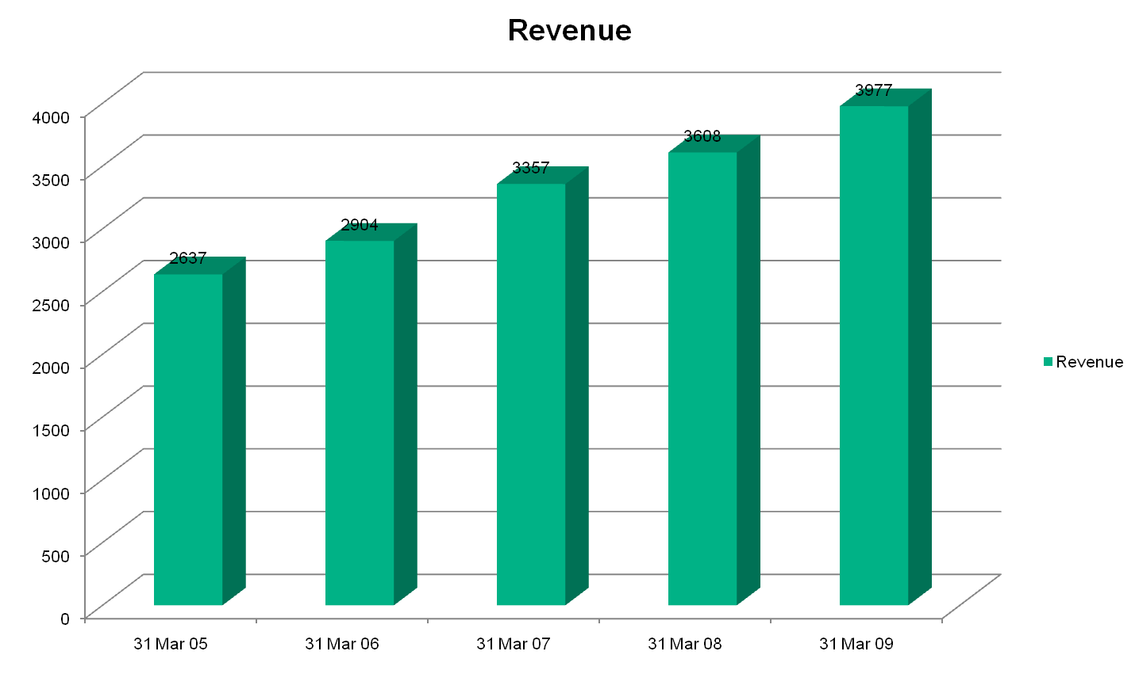
Revenue growth

Slide 25
Revenue growth (continued)
Achieved budget revenue growth of 10%
Growth areas:
  Labour ( 8%)
  Network and internet (20%)
  Software licenses and maintenance (27%)
  Project revenue (159%)
  Sundry (111%)
Reduction:
  Computer equipment and maintenance (22%)
  Mainframe income (10%)

Slide 26
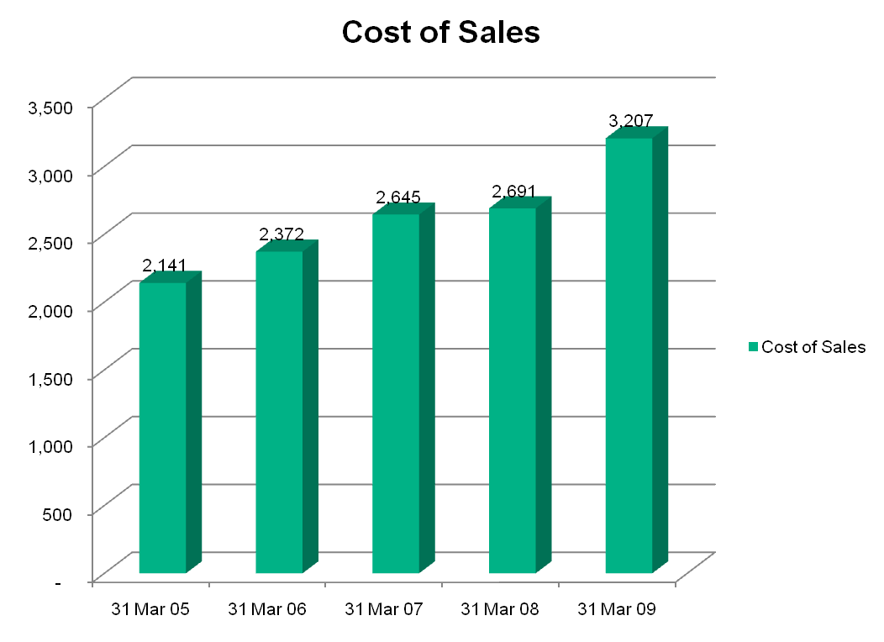
Cost of sales – 2009 in R’m

Slide 27
Cost of sales (continued)
Increased from previous year:
  Depreciation (66%) due to capital expenditure in previous and current year
  Direct Labour (18%) due to higher demand
  Service delivery overheads (48%) due to agency transactions and computer equipment and maintenance costs

Slide 28
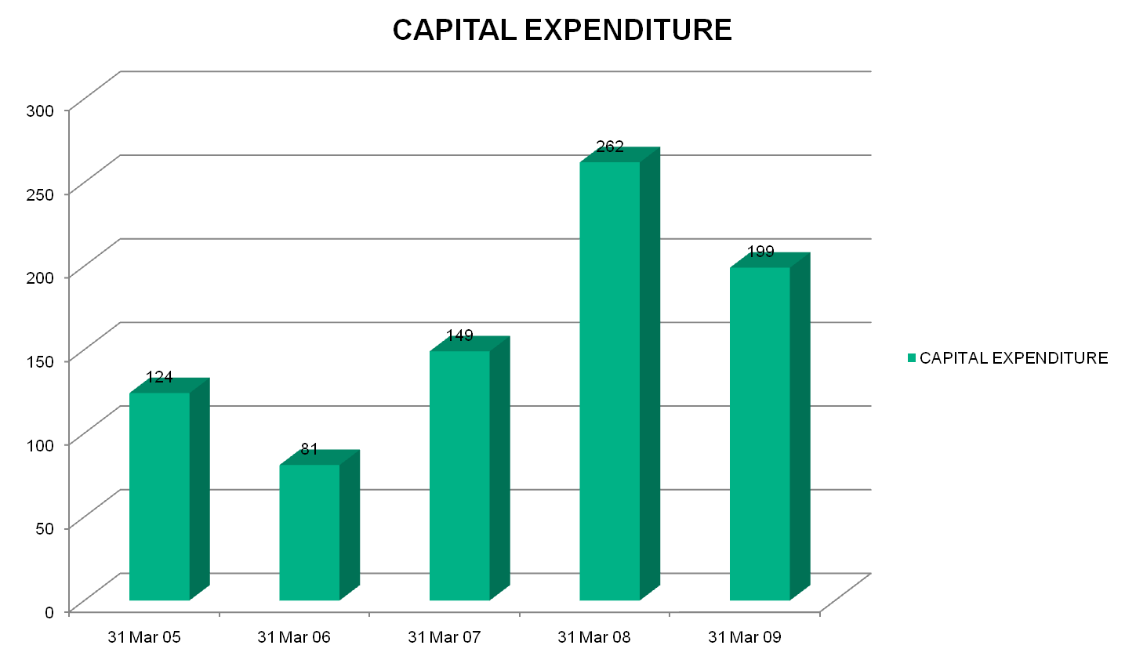
Capital expenditure – R’m

Slide 29
Capital expenditure (continued)
Areas of spending on Capital Expenditure:
  Buildings: R20m
  Computer equipment: R110m
  Office furniture: R33m
  Intangible assets (software): R36m

Slide 30
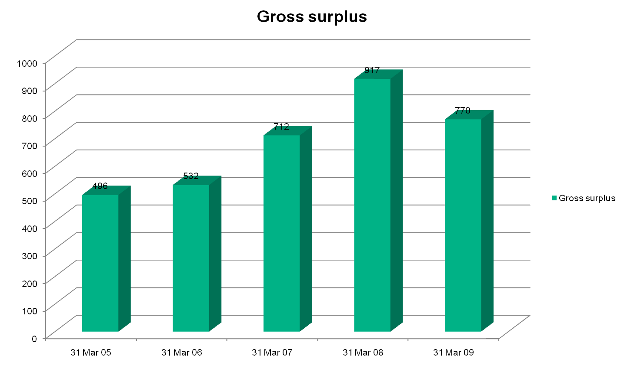
Gross surplus – R’m

Slide 31
Gross surplus (continued)
Reasons for decrease
  Increase in agency transactions which translates into lower gross margin
  Reduced tariffs in mainframe environment (R225m) to support lower expenditure for government

Slide 32
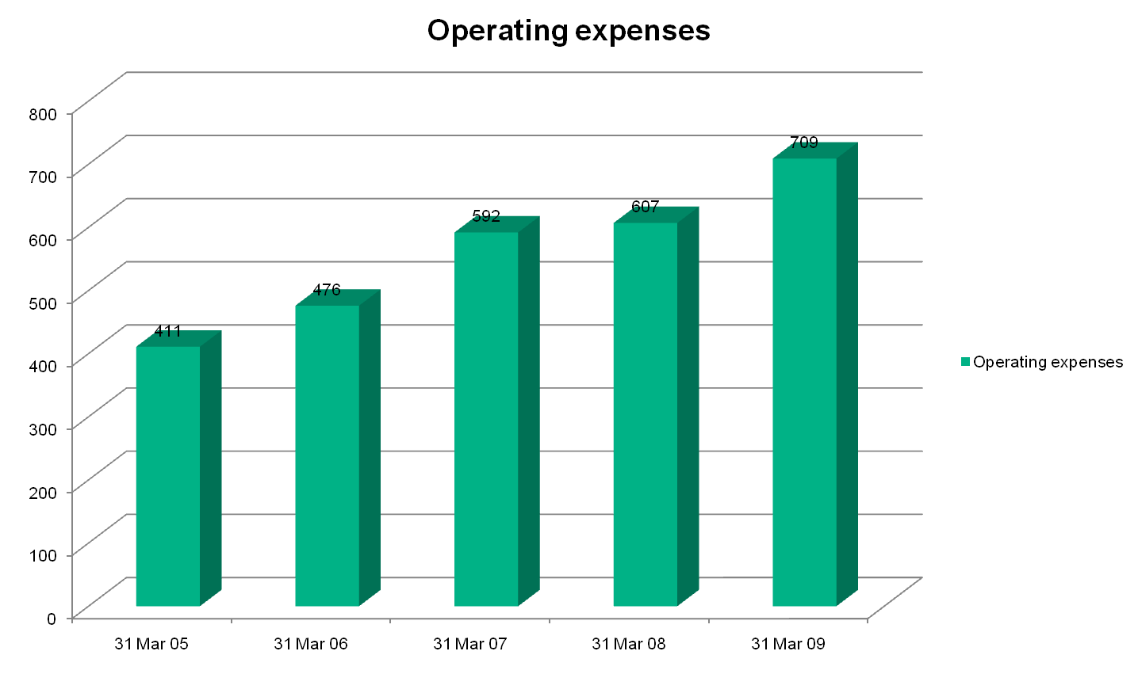
Operating expenses – R’m

Slide 33
Operating expenses
Reasons for increase:
  Operating leases (R13m)
  Foreign exchange loss (R11m)
  Impairment on trade receivables (R16m)
  Audit fees (R4m)

Slide 34
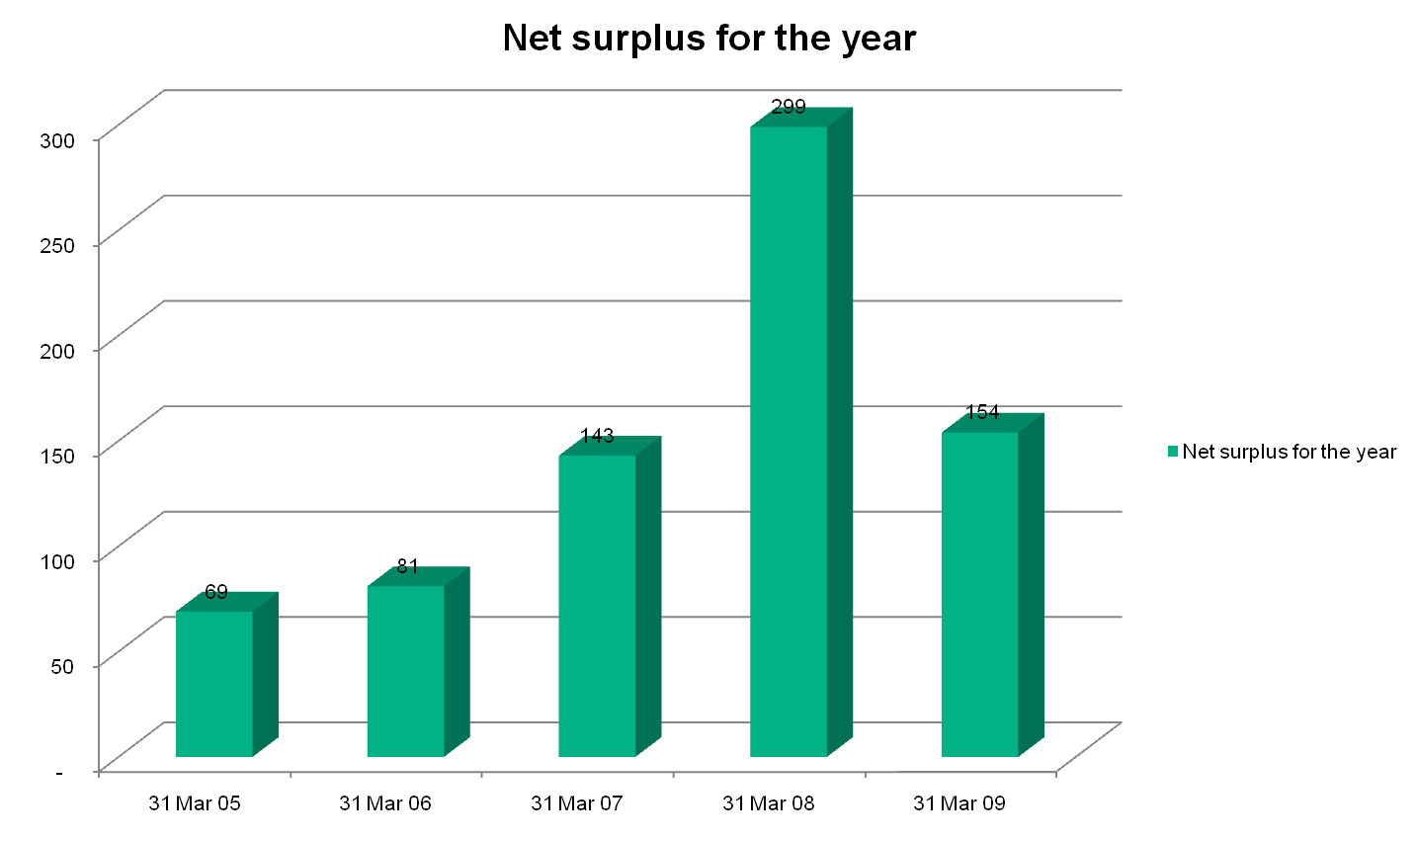
Net surplus – R’m

Slide 35
Net surplus
Reasons for decrease
  Lower gross surplus
  Increase in Operating expenditure

Slide 36
Thank you

